Slide 1
Department of Children and Families
Care Provider Background Screening Clearinghouse

Slide 2
Care Provider Background Screening Clearinghouse
In response to the requirements passed during the 2012 Legislative session, the Agency for Health Care Administration (AHCA) created the Care Provider Background Screening Clearinghouse, or “Clearinghouse” Website.
The legislation specified the agencies to be included in the Clearinghouse.

Slide 3
Specified Agencies
The following agencies are included in the Clearinghouse:
Agency for Health Care Administration
Agency for Persons with Disabilities
Department of Children and Families
Department of Elder Affairs
Department of Health
Department of Juvenile Justice
Division of Vocational Rehabilitation

Slide 4
Clearinghouse Advantages
Allows each agency to make a determination on screening results using criteria established for the programs they oversee.
Creates a “status” report and a “completed screening listing” report of screenings requested by the user eliminating the need to search for each screening result individually.
Maintain an employee roster by entering hire and separation dates for each employee. This facilitates a notification if the eligibility status of an employee changes. This must be done within 10 business days of action.

Slide 5
Changes from Current Practice
Providers will no longer utilize the DCF Background Screening Web Portal.
Providers will no longer receive the “DCF Clearance Letter” but will have access to the FDLE Public Record with their screening.
The provider will print the screen for documentation.
Providers will be required to use the Clearinghouse to request screenings and maintain employee roster.
New ORI’s will be issued and there will be fewer ORI’s.

Slide 6
Creating an Account
Select New User Registration

Slide 7
Acknowledgement

Slide 8
Registration

Slide 10
Completion of Registration

Slide 11
The Clearinghouse Process

Slide 12
Select Agency

Slide 13
Select Your role

Slide 14
Select your provider type

Slide 15
Select your Provider

Slide 16
Submit Request

Slide 17
Complete User Agreement

Slide 18
Clearinghouse Home

Slide 19
Search Screen
To Search Enter:
Social Security Number AND
Last Name OR
Date of Birth
Select ‘Search’

Slide 20
Initiate Screening
If the individual has not previously been screened through the Clearinghouse, select the Initiate Screening Button.
If the individual is in the Clearinghouse, the provider will request a DCF Screening Review.

Slide 21
Initiate Screening
Request a screening and schedule an appointment for an employee live scan.
Enter all required information, as designated by the red asterisks (*).
Ensure all information is accurate and select the ‘Next’ button.

Slide 22
Initiate Screening
Select the position type that individual is applying for from the drop down list.
Select the type of screening required to hire the individual by selecting ‘Yes’ or ‘No’ for each type.
Select the ‘Privacy Policy’ link to view and print the privacy policy. Check the affirmation box to confirm that the applicant has signed and agreed to the Privacy Policy.

Slide 23
Livescan Search
Allows providers to search for approved Live Scan Service Providers.

Slide 24
Livescan Search
Allows the user to select from a search of Live Scan approved operators, or skip if they have other access to a Live Scan machine.

Slide 25
Scheduling an Appointment
Select a Live Scan Provider.
Set an appointment for fingerprinting.

Slide 26
Screening Request Completed
The system will confirm when the screening request has been submitted.
You can print the screening appointment form.

Slide 27
Appointment Request Form
The applicant will provide this form to the Live Scan Service Provider when being fingerprinted.

Slide 28
Person Profile
Contains the screening eligibility status .
View the public version of the criminal history report (if you initiated the screening).
Connect to a screening that is already in process
Receive notifications when the screening is complete.
Provides an employment history for the individual as reported by any provider regulated by an Agency in the Clearinghouse.

Slide 29
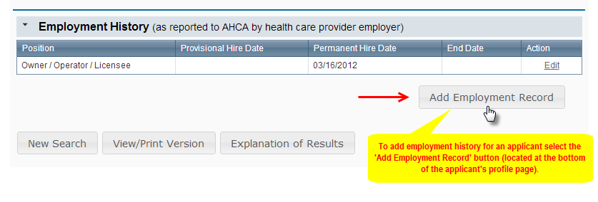
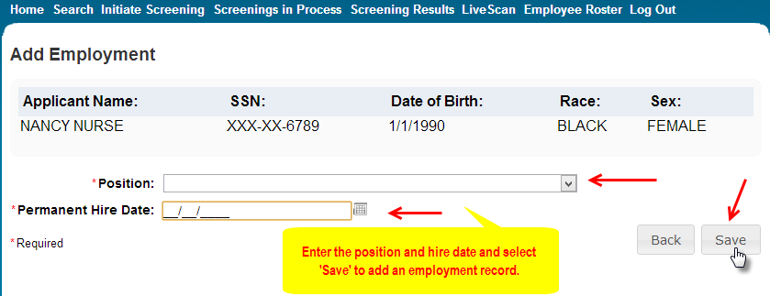
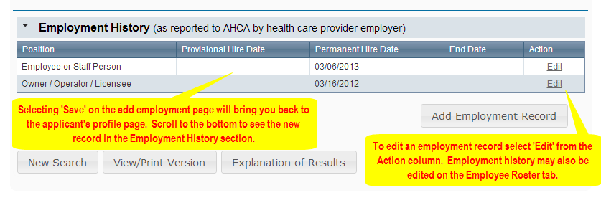
Add Employment Record
Providers must register with the clearinghouse and maintain the employment status of all employees within the clearinghouse.
Initial employment status and any changes in status must be reported within 10 business days.

Slide 30
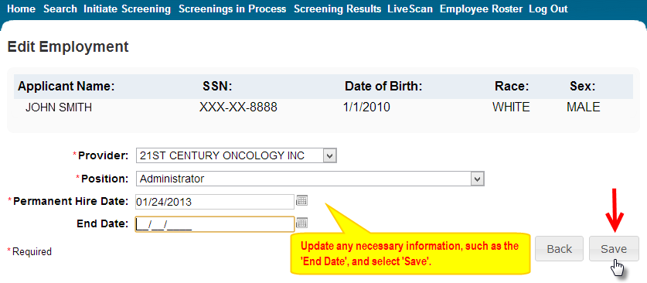
Add/Edit Employment Record
For those employees hired prior to the completion of screening for orientation or training purposes, the provider may add a provisional hire date for an applicant with a current ‘Screening in Process’.
Providers will use this screen to record any change in employment.

Slide 31
Screenings In Process
Provides a listing of all screening requests initiated or connected to and the current status.
Requests will remain on the list for 7 days once a determination is made.
View an individual’s profile page by selecting the last name of the individual.
Filter the list by using the search options and selecting ‘Apply’.
Sort the list by selecting a column header.

Slide 32
Screening Results
Provides a listing of all screening requests initiated or connected to and the final determination.

Slide 33
Employee Roster
Provides a listing of employees as entered through the Employment History section of the individual’s profile page.

Slide 34
DCF Person Profile view

Slide 35
Questions?

